Slide 1



Fieldglass UI Framework
Siddhesh Popat
Sydney Monis
February 4, 2016

Slide 2
Agenda
Introduction
About SAP Fieldglass
Complexity of a large Web Application
Why?
Reasons for building the framework
What?
Our Solution
Standard Patters
UI Layouts
How?
Structure of jsp pages
Javascript Components

Slide 3

Introduction

Slide 4
SAP Fieldglass
Global Leader in Vendor Management System (VMS), highly configurable Fieldglass operates in the cloud, providing transparency into the contract workforce to help companies procure, manage and make strategic labor decisions regarding:
Contingent labor
Services like Statement of Work, RFx, Projects etc.
Independent contractors
A SaaS based solution (one code-base and one database) caters to multiple domains including BFS, Healthcare, Telecom, Manufacturing, Energy, Hospitality etc. and is increasing its footprint in new areas year on year.
Year Founded: 1999
Acquired by SAP: 2014
Customers: 400+
Supply Base: 10,000+
Countries with Active Spend: 120+
User-base: 10 Million+

Slide 5
Complexity of a large web application
~ 1500 different pages
~ 2500 JSP files
~ 30 css files
~ 50 .js files
Support different browsers and devices

Slide 6
Why?

Slide 7
Reasons for Building the Framework
Same look & feel
Flexibility (Allow for easily changing all the pages, so we can respond quickly to the changing needs and wants of the company and customers)
Time Complexity (Reduces the development & testing time)
Ease of training for new development.

Slide 8
What?

Slide 9
Our Solution
Built framework for managing the different patterns (layouts).
Built a library of custom tags to generate different common elements
Unified CSS
Unified JS library
Built a library of Js widgets (some based on common jQuery plugins)

Slide 10
Standard Patterns (layouts)
List page
Detail Object page
Data Entry page
Modal panel
Administration pages

Slide 11
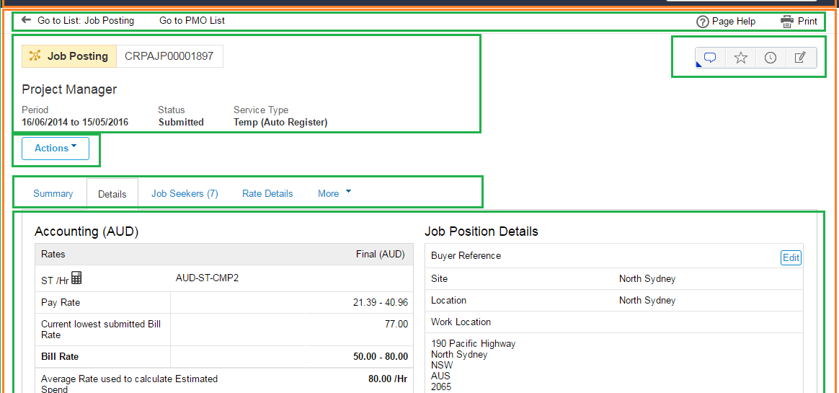
SAP Fieldglass UI

Slide 12
How?

Slide 13
Structure of JSP page
<deco:layout file="/layouts/layout_base.html" noCache="true">
<deco:panel name="title" value="${title}"/>
<deco:panel name="menuBar" >
<insite:menuBar/>
</deco:panel>
<deco:layout name="body" file="/layouts/layout_list.html" noCache="true">
<deco:panel name="badge">
<insite:badge title="${title}” ……/>
</deco:panel>
<%---- PAGE CONTENT COMES HERE ----%>
</deco:layout>
</deco:layout>

Slide 14
Javascript Components
FGGrid
new FG.Grid({
jsonObject: statementOfWorkGridData
});
FGTooltip
new FG.Tooltip({
element: $('#infoIcon'),
text: 'Hi, I am the text within a tooltip'
}).initialize();
FGSessionReviver
FG.SessionReviver({
warningPeriodBeforeTimeoutSeconds: 100,
serverSessionTimeoutSeconds: 1200
}).enable();

Slide 15
Thank you
Contact information:
Siddhesh Popat
Developer Associate
Mumbai
9702017879
Sydney Monis
Developer Associate
Mumbai
9930781666

